Slide 1

Data Cleaning process with sql for layoffs datset
Srividya
Jan 16,2025

Slide 2

Agenda
Introduction
Challenges in dataset
Data cleaning step by using SQL
Tools and Technologies
Cleaned Data overview
Insights Unlocked

Slide 3

Introduction
The main objective of this project is to clean and standardize the layoffs dataset using SQL queries to ensure accurate and reliable analysis. The data cleaning process will be carried out in four key steps.

Slide 4
Challenges in dataset
While performing data cleaning process we face different types of challenges ass follows:
1. Handling missing values
2. Duplicate Records
3. Dealing with Null values
4. Inconisistent data fromate
5. Detecting and correcting logical error
6. Large dataset

Slide 5

Data cleaning steps by using SQL
Performed four steps to clean and analyse the datset as follws:
1. Remove Duplicates
2. Standardize the data
3. Null values or blank values
4. Remove any columns

Slide 6
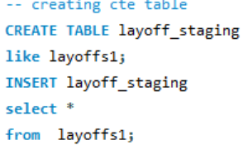
1. Remove duplicates
Step 1: To remove duplicates, I am creating a temporary duplicate table to ensure the
original data remains intact during the operations.
Step 2: This table is created using command functions.
Step 3: All data cleaning operations, including duplicate removal, will be performed on
this table instead of the main table.

Slide 7
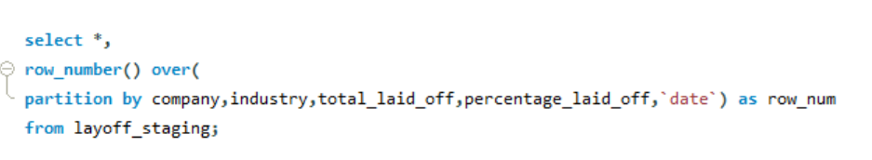
Step 1: Identify duplicate rows using window functions like Row_number()..
Step 2: Check for rows with a ranking greater than 1 to detect duplicates.

Slide 8
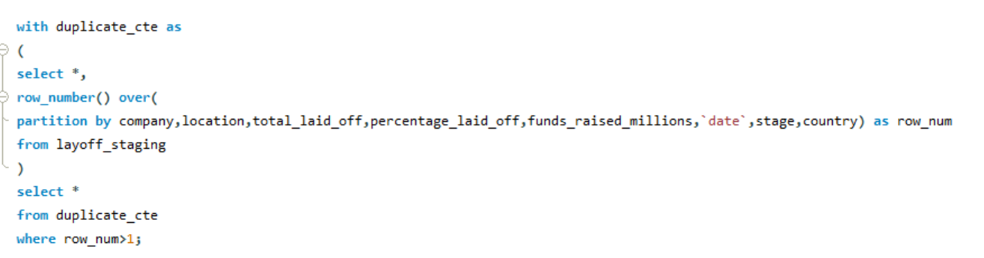
Create a Common Table Expression (CTE) to identify or filter the duplicate rows in the dataset.
Use the CTE to detect and remove all duplicate values efficiently.

Slide 9
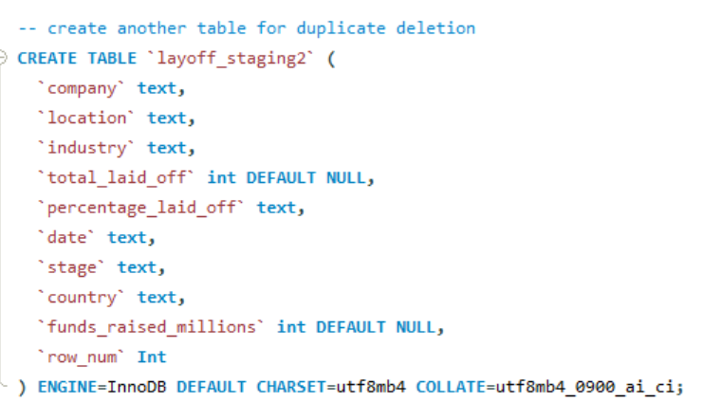
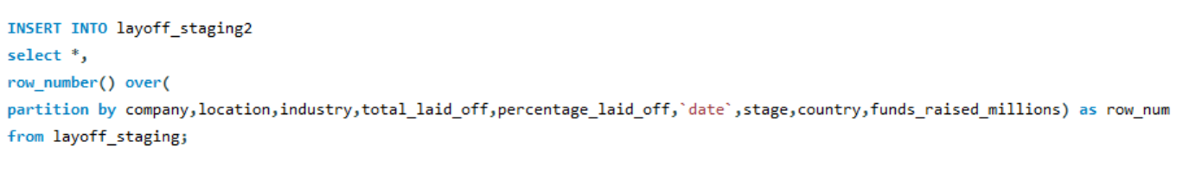
Creating a another duplicate table to identify and delete all duplicate rows without modifying the main table.
This ensures the original dataset remains intact, preserving the main data rows.

Slide 10
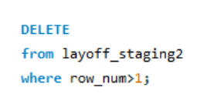
Filter rows where row_num greater than 1 to identify and delete the duplicate records.

Slide 11
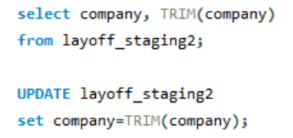
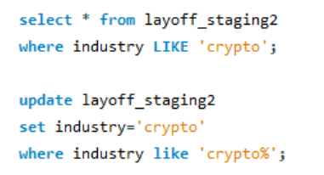
2.Standardize The Data
Used the TRIM() function to remove leading and trailing spaces from text fields.
Standardized industry name formats by converting them into a consistent structure for
unifomity.

Slide 12
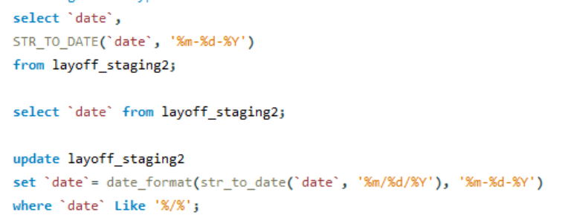
Check the date datatype and update it with date .

Slide 13
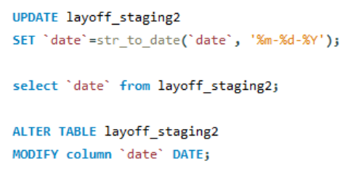
If the data type of the date column is still incorrect, use the ALTER statement to modify it and ensure consistency.

Slide 14
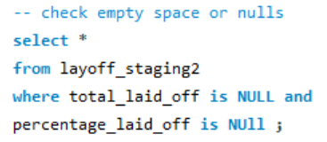
3. Null values or Blanck values
Check the NULL values or Blank spaces present in the table.

Slide 15
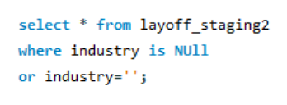
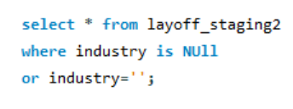
Check the industry column for the Null values or blanck spaces.
Select all the rows where the industry is industry is NULL

Slide 16
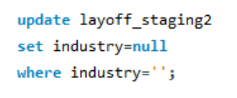
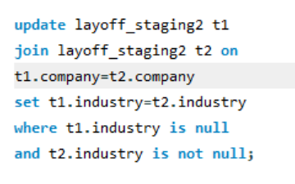
Updated the industry column in the layoff_staging2 table by joining it with itself (self-join).
Logic:
Matched rows based on the company name.
Replaced NULL values in t1.industry with non-NULL values from t2.industry.
Ensures missing industry values are filled consistently across records.
Change all the empty spaces into NULLs to perform easily.

Slide 17
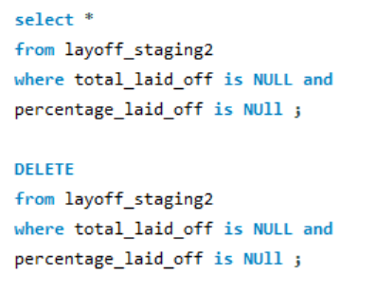
Delete all the Null values from the column total_ laid_off and percentage_laid_off in the table.

Slide 18
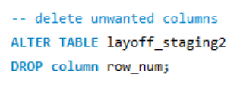
4.Remove any columns
Delete all the unwanted columns from the table.

Slide 19
Summary
Used Commands / functions:-
UPDATE
DELETE
ALTER
CTE
JOINS
DROP
IS NULL
DATE FORMATE()
ROW_NUMBER()
WINDOW FUNCTIONS

Slide 20

Conclusion
Thank you for taking the time to review this project. I sincerely welcome any corrections or suggestions for improvement to help refine the work further."
PONNALA SRIVIDYA
ponnalasrividya11@gmail.com

Slide 21

THANK YOU
PONNALA SRIVIDYA

